Slide 1
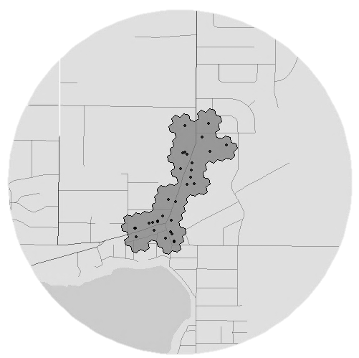




A Framework for Delineating the Scale, Extent and Characteristics of American Retail Centre Agglomerations: The Case of Chicago Metropolitan Area during COVID-19
Patrick Ballantyne, Alex Singleton, Les Dolega, Kevin Credit
GISRUK Spring 2021 [virtual]
@pj_ballantyne
Notes:
Introduce yourself, research interests (GIS/Spatial methods, R, retail environments)…
First paper of my PhD
PhD focus is on American Retail Centre definitions
Currently at a journal, awaiting feedback

Slide 2
Part 1:
Retail Centres
SafeGraph Data
Delineating Urban Retail Centres
A Typological Perspective on Retail Agglomeration
Retail Sector Response to COVID-19
Overview
@pj_ballantyne
Notes:
So the focus of this talk will be on the Paper itself, whizzing through:

Slide 3
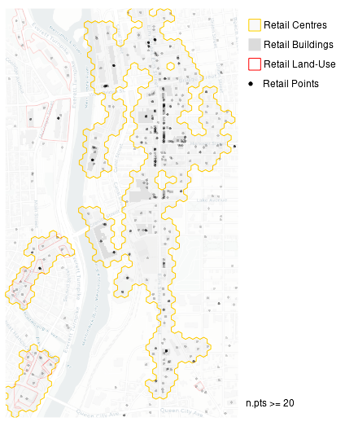
Part 1:
Retail Centres SafeGraph Data
Delineating Urban Retail Centres
A Typological Perspective on Retail Agglomeration
Retail Sector Response to COVID-19
Part 2:
Expanding the ‘Geography’ of this Research
Overview
@pj_ballantyne
Notes:
However in the last couple of minutes, I also wanted to showcase how we are enhancing this for another paper, with methodological improvements to extract a national scale retail centre classification for the US.

Slide 4
“Concentrations of individual retail units and their associated activities”
Berman and Evans (2013)
Retail Centres – The ‘Place’ of Retailing
@pj_ballantyne
Notes:
This is a working definition from my thesis – but we can also think of these as being ‘highly-dynamic’ (responding to external pressures/opportunities) and inherently geographic entities.

Slide 5
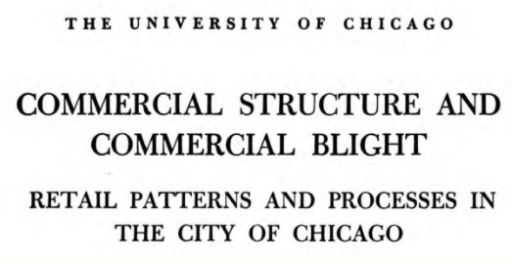
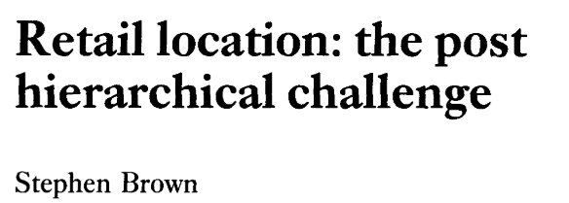
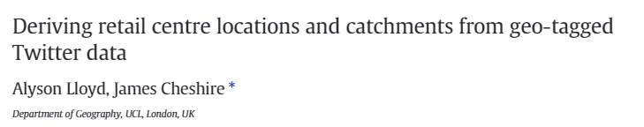
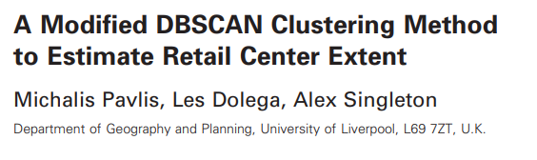
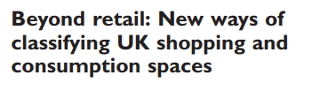
Berry (1963))
“Concentrations of individual retail units and their associated activities”
Berman and Evans (2013)
Brown (1992))
Dolega et al. (2019)
Retail Centres – The ‘Place’ of Retailing
@pj_ballantyne
Notes:
Lots of related literature – Berry & Brown’s work on Form & Function classifications of retail centres
More recently, better methods & data have yielded more comprehensive and automated approaches to do so!

Slide 6
Berry (1963))
Understanding the WHERE and WHAT
“Concentrations of individual retail units and their associated activities”
Berman and Evans (2013)
Brown (1992))
WHERE
WHAT
Dolega et al. (2019)
Retail Centres – The ‘Place’ of Retailing
@pj_ballantyne
Notes:
Focus is on the WHERE and WHAT
WHERE – pulled our method from Pavlis et al. (2018), which used a modified DBSCAN approach to delineate the WHERE
WHAT – used and enhanced a typological classification framework proposed by Dolega et al. (2019), non-hierarchical/multidimensional

Slide 7
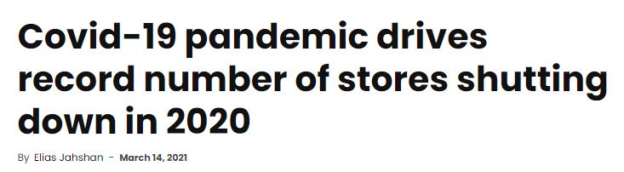
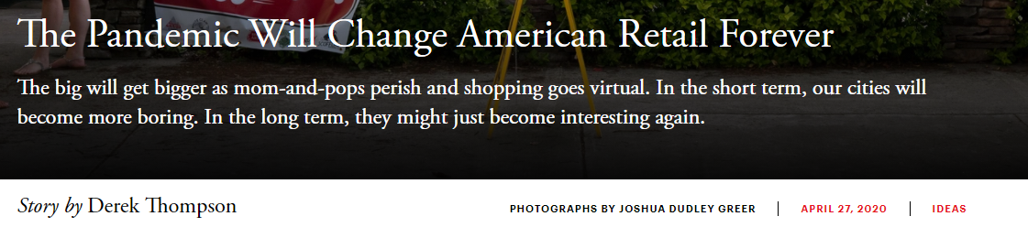

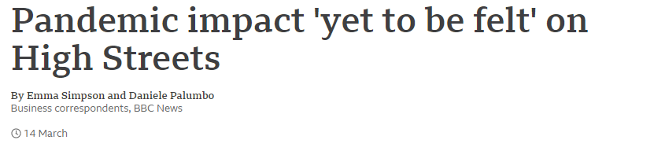
Retail Centres – Understanding Retail Dynamics
@pj_ballantyne
Notes:
Retail has faced immense pressures – E-Commerce, Rising Vacancy Rates, closure of major brands that once characterised high streets
More recently, these problems have been exacerbated by the COVID-19 pandemic.

Slide 8
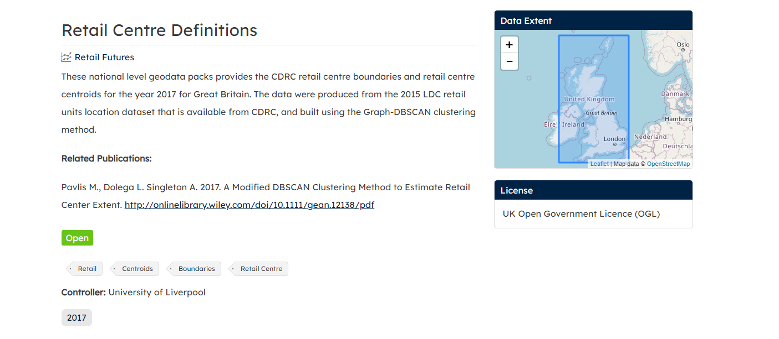

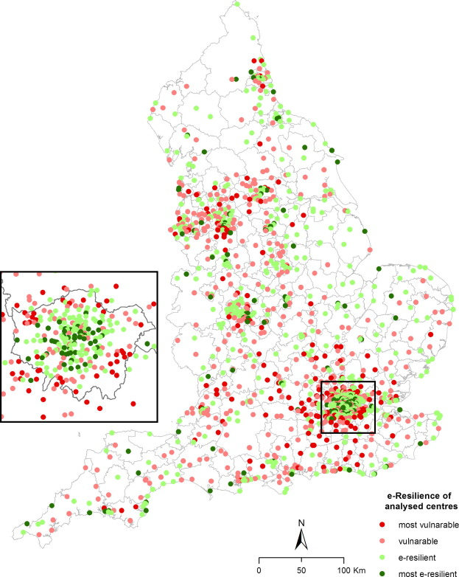
Ballantyne et al. (forthcoming)
Singleton et al. (2016)
Retail Centres – Understanding Retail Dynamics
@pj_ballantyne
Notes:
This is where Retail Centres can be useful!
Retail evolution is an inherently dynamic process, and a pressing issue for both academics & stakeholders
Having ways to monitor the health of retail locations has become important
Retail centres can act as tools to assist with this – enabling insights into present day retail provision but also historical
Creation of metrics (e.g. E-Resilience)
Use of mobility data to look at how different structures and functions of retail are responding the these challenges.

Slide 9
Understanding the WHERE and WHAT
Ballantyne et al. (forthcoming)
Singleton et al. (2016)
Retail Centres – Understanding Retail Dynamics
@pj_ballantyne
Notes:
HOWEVER, it is only possible to monitor the health/evolution of retail centres once we have a comprehensive understanding of their WHERE & WHAT
WHERE – Their extents, geography
WHAT – Distinguishing characteristics

Slide 10


Data
@pj_ballantyne
Notes:
SafeGraph Data Consortium:

Slide 11

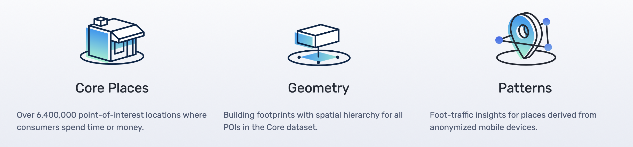
106,058 ‘Retail’ Core Places In Chicago MSA
Data
@pj_ballantyne
Notes:
Access to the ‘Core Places’ database:
Available for the US & Canada
6.4 million POIs
Highly accurate – 99% accuracy in identification of attributes, and majority of POIs were within 10m of their location of google maps!
Extracted the retail places for Chicago – based on LDC principles

Slide 12
A Framework for Delineating the Scale, Extent and Characteristics of American Retail Centre Agglomerations: The Case of Chicago Metropolitan Area during COVID-19
@pj_ballantyne

Slide 13
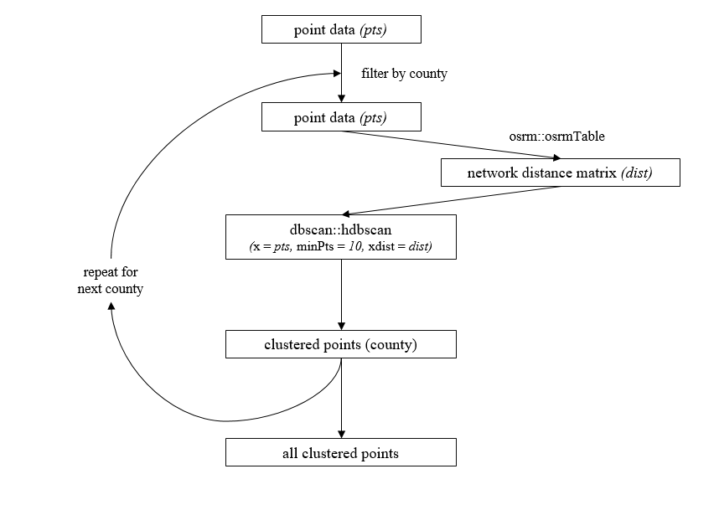
Delineating Urban Retail Centres (1)
@pj_ballantyne
Notes:
Taking into account the limitations of the Modified DBSCAN approach (transparency, customisation to the dataset, complexity), we utilised Hierarchical-DBSCAN as a more intuitive and robust spatial clustering algorithm to the M-DBSCAN approach (only one input parameter, ability to automatically account for heterogeneous point densities) - MinPts
We also used network distance matrices to account for road networks in the clustering – network over euclidean, open source routing machine.
Novel approach to retail centre delineation – HDBSCAN & Network Distances
Result is a set of cluster labels for the points.

Slide 14
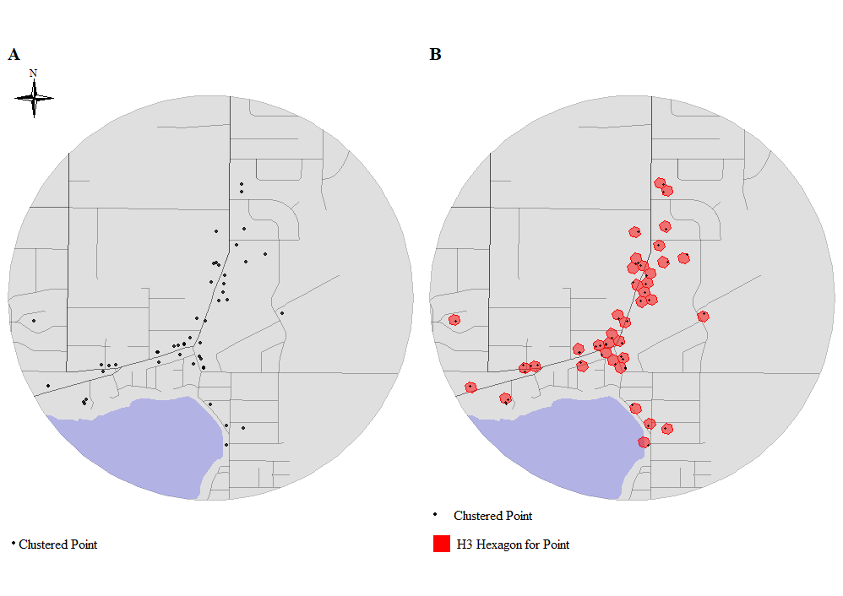
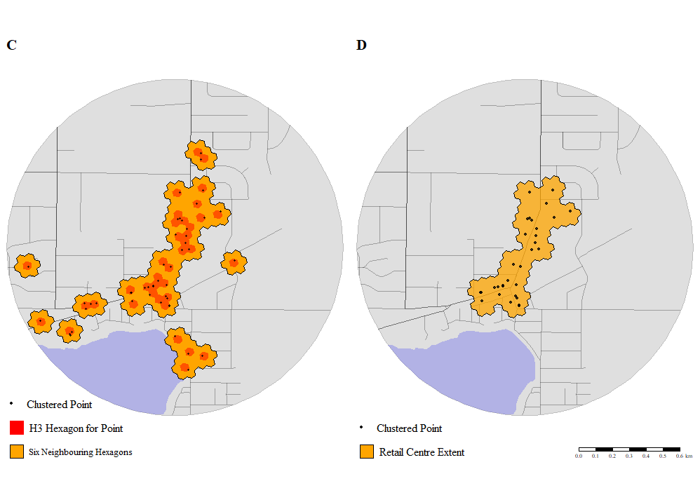
Delineating Urban Retail Centres (1)
@pj_ballantyne
Notes:
However, we wanted to refine these further and extract the boundaries beyond just the points themselves.
Developed a four stage approach utilising the H3 spatial indexing system, using the h3jsr R package, to extract the final cluster boundaries. Talk through how it works…

Slide 15
Delineating Urban Retail Centres (2)
@pj_ballantyne
Notes:
Overall, we ended up with 1,599 retail centres for the Chicago MSA – many in the CBD, in satellite cities and along major transport arteries.
We consider the results in two key case study areas:
CBD of Chicago – The Loop (SC1), The Magnificent Mile (NC1)
Schaumburg Village (shopping malls, large retail area) – Woodfield Mall (WC3), Woodfield Green Retail Park (WC27)
Roughly captures the distribution of retail agglomerations in Chicago – couple of limitations:
Use of points over polygons
County-level delineation

Slide 16
A Framework for Delineating the Scale, Extent and Characteristics of American Retail Centre Agglomerations: The Case of Chicago Metropolitan Area during COVID-19
@pj_ballantyne

Slide 17
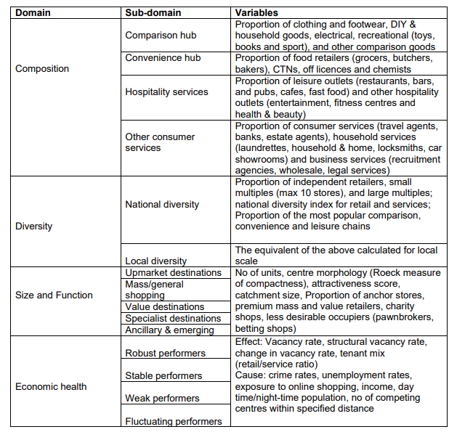
Dolega et al. (2019)
Dolega et al. (2019)
A Typological Perspective (1)
@pj_ballantyne
Notes:
The framework we used to classify the retail centres is pulled from Dolega et al. (2019):
Data-Driven, Automated Approach to Retail Classification
Non-Hierarchical – all dimensions of retail are treated as equal

Slide 18
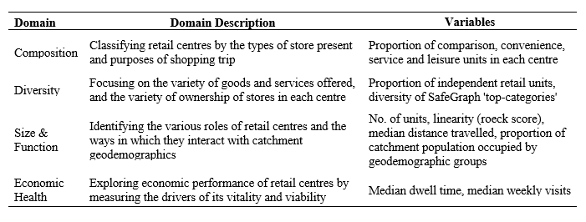
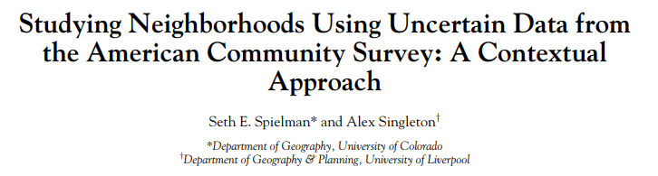
Dolega et al. (2019)
Spielman and Singleton (2015)
A Typological Perspective (1)
@pj_ballantyne
Notes:
We tried to extract similar variables as those in Dolega et al. (2019), utilising for the most part the SafeGraph core places themselves, ended up with 24 variables.
In addition we incorporated the ‘patterns’ data – mobility data for the core places, total weekly visits etc.
US Geodemographic classification used to extract neighbourhood characteristics.

Slide 19
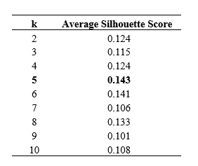
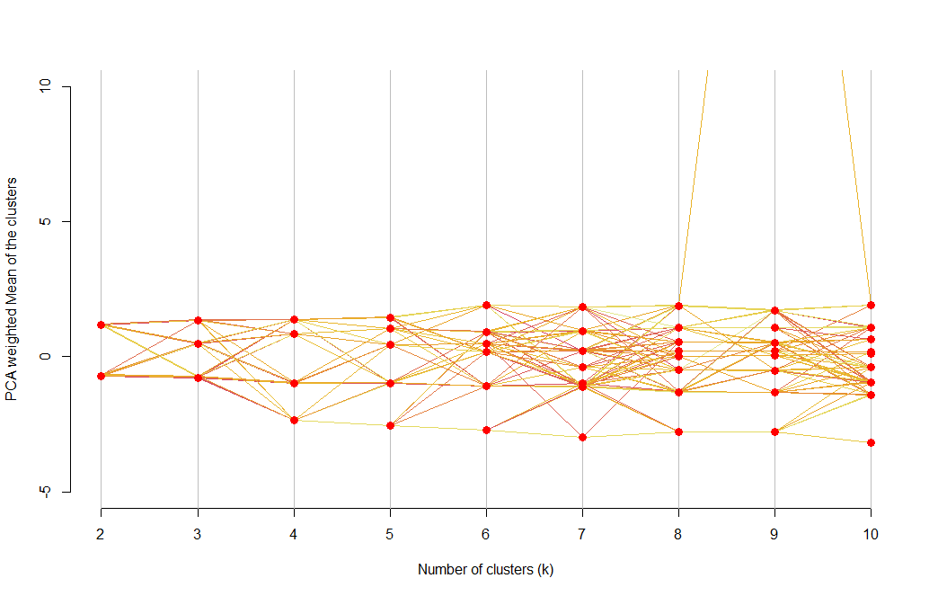
Dolega et al. (2019)
A Typological Perspective (1)
@pj_ballantyne
Notes:
Once we have the variables we use PCA to reduce dimensionality and then run PAM to extract retail centre groups!
We run it twice, first to extract a set of retail centre groups, then to extract a subsequent set of retail centre types
We use average silhouette scores and clustergrams to identify suitable number of groups and types for each iteration of PAM.

Slide 20
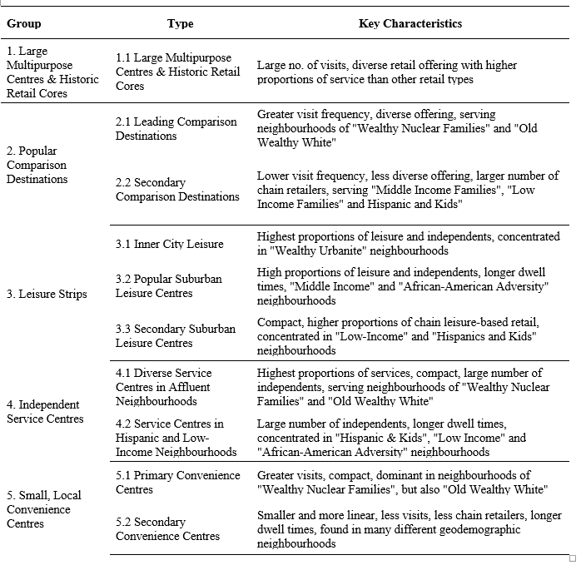
A Typological Perspective (2)
@pj_ballantyne
Notes:
Overview of typology – Two-Tier
Group 1 centre: ‘cores’ of urban areas – Chicago, Elgin etc.
Comparison destinations – 3.1 were leading destinations (e.g. fashion outlets)
Groups 4&5 dispersed throughout the MSA

Slide 21
A Typological Perspective (2)
@pj_ballantyne
Notes:
Interesting patterns emerged!
Chicago:
Group 1 centres – these are major retail corridors, lots of leisure
Schaumburg – dominance of comparison & service, interesting distinction between 3.1 (Woodfield Mall) and 3.2 – small, homogenous retail offering
Limitations again:
Affected by shape
Metropolitan typology

Slide 22
A Framework for Delineating the Scale, Extent and Characteristics of American Retail Centre Agglomerations: The Case of Chicago Metropolitan Area during COVID-19
@pj_ballantyne
Notes:
In this final section, we wanted to demonstrate the usefulness of retail centres, for helping to understand how different structures and functions of retail respond to wider threats/economic challenges.
We adopted an exploratory approach to see if COVID-19 resulted in differences in foot-traffic around different types of retail centres.
From the literature, this was expected – lots of work on the role of local lockdowns on mobility reductions and differential mobility depending on types of goods being offered.

Slide 23
COVID-19
@pj_ballantyne
Notes:
We use the SafeGraph patterns data again – gathered total visits for the retail centre groups for a year period – September 2019 – September 2020.
Calculated share change between different groups of centres to look at how visit frequencies shifted on the whole between different structures and functions of retail.

Slide 24
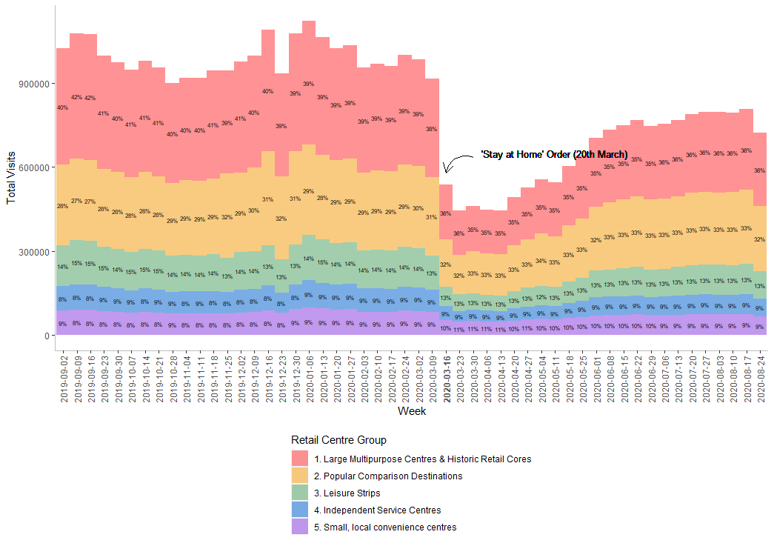
COVID-19
@pj_ballantyne
Notes:
Generally, mobility declined with ‘Stay at Home’ order…
Group 1 centres saw an apparent decrease in share (c. 2%), whereas Group 5 saw increased share, which was sustained for the following months.
Trend: shift away from large city centre agglomerations to the smaller more local ones – a well-documented trend during the pandemic.
Longer term: Group 1 centres continue to occupy a 4-5% reduction on average, speculation of accelerated high street decline?

Slide 25
Where Next?
@pj_ballantyne
Notes:
Aim of the next paper is to build a National classification of Retail Centres for the US, building on the limitations of this paper (HDBSCAN, metropolitan typology)

Slide 26
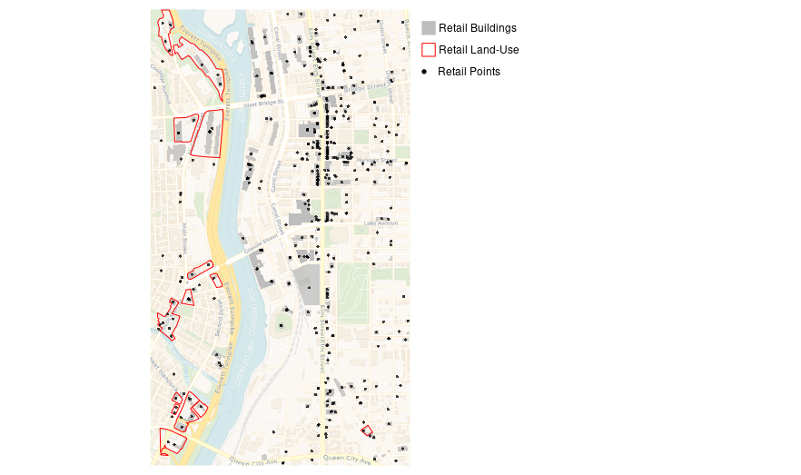
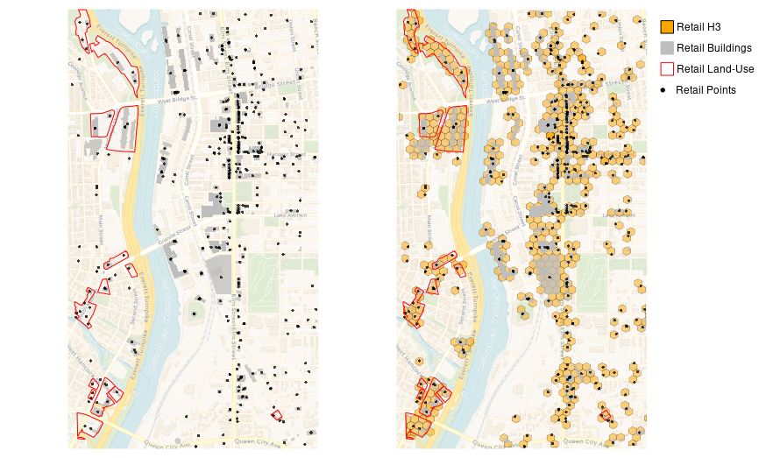
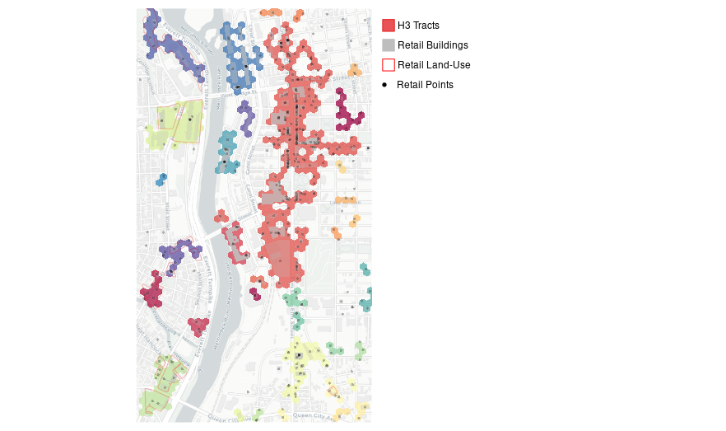
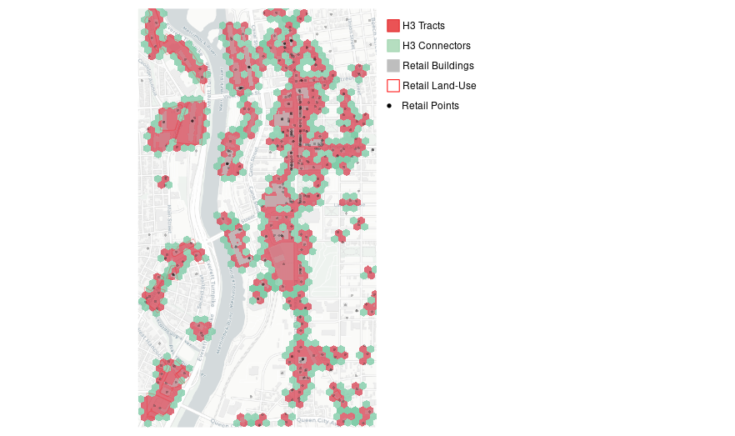
@pj_ballantyne
Notes:
Each of these hexagons has a unique H3 address, and we are then able to identify using some of the neighbouring functions in h3jsr the relationships between each of these unique H3’s.

Slide 27
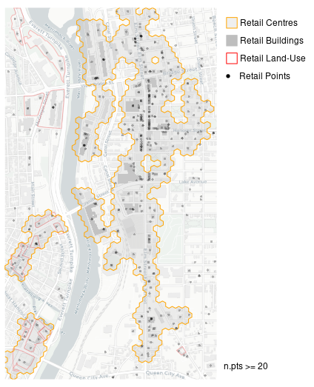
@pj_ballantyne
Notes:
And then we can pull out a final set of retail centre boundaries – some additional caveats for major retail centres, those larger than neighbourhood centres – ICSC (n.pts >= 20), accounting for major urban features (rivers, lakes, waterbodies etc.)

Slide 28
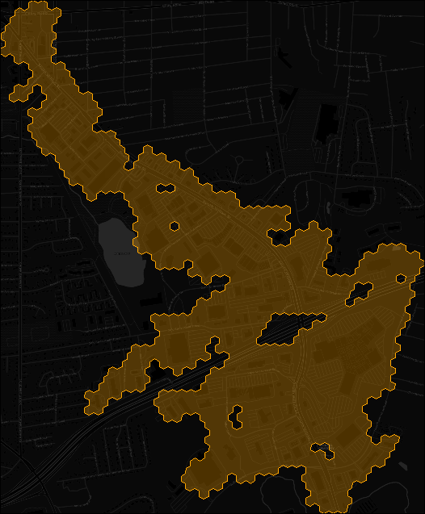
Size & Function:
Size, Shape, Density of Buildings and Roads, Retail Employment Densities, General Employment & Residential Densities, Distance to Transit, Geodemographics?
Composition:
Comparison, Convenience, Service and Leisure Mix
Diversity:
National Chains vs Independents, Heterogeneity of Retail Categories
Economic Health:
Visits, Dwell, Vacancy Rate?
@pj_ballantyne
Notes:
Again we use the framework from Dolega et al. (2019) – additional variables (post Kevin comments, urban structure, retail specific etc.)

Slide 29
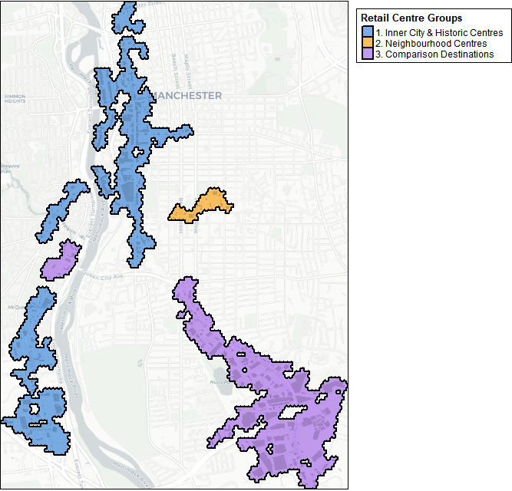
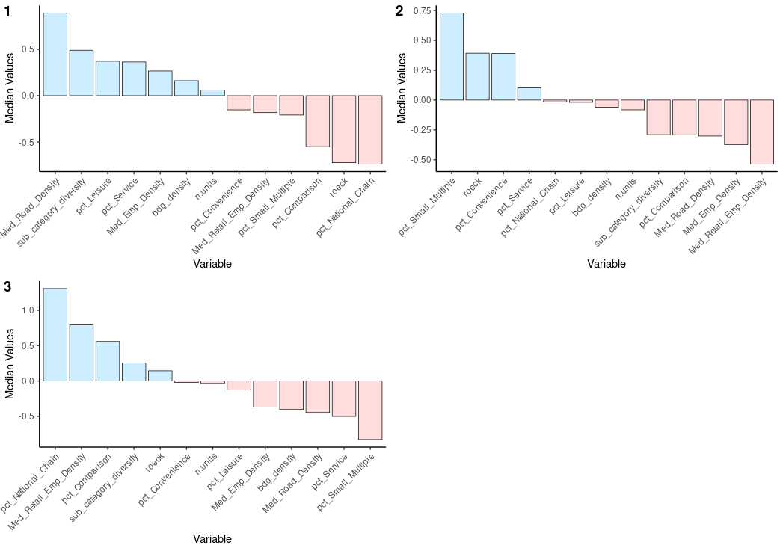
@pj_ballantyne
Notes:
Some interesting patterns!

Slide 30
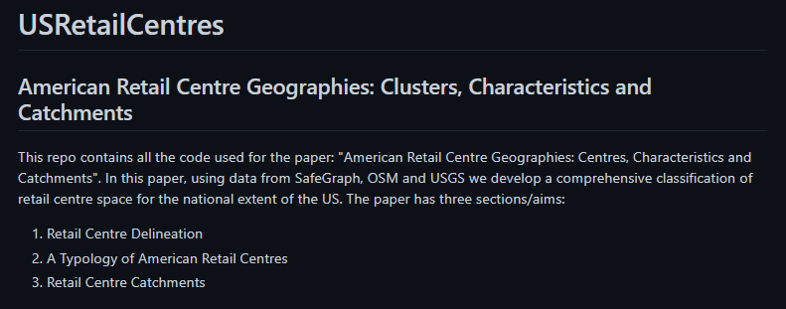

patrickballantyne/USRetailCentres
@pj_ballantyne
Notes:
Paper 2 – Push to GitHub!

Slide 31
A Framework for Delineating the Scale, Extent and Characteristics of American Retail Centre Agglomerations: The Case of Chicago Metropolitan Area during COVID-19
Patrick Ballantyne, Alex Singleton, Les Dolega, Kevin Credit
Thanks for listening! Questions??
@pj_ballantyne
Slides @ github.com/patrickballantyne/ChicagoRetailCentres
Notes:
Slides @
Follow me on Twitter – would love to hear from you!

